Slide 1
NAME - 400 Project & Thesis
Supervised by,
Dr. N. M. Golam Zakaria
Professor,
Dept. of NAME,
BUET.
Presented by,
Touseef Hasan
Student ID: 1812044,
Shamsul Islam
Student ID: 1812039.

Slide 2
Title
“ A Material Flow Analysis of the
Ship-Breaking Industry in Bangladesh
using Machine Learning. ”

Slide 3
Objectives
Development of a concept design tool for 4 major ship types, i.e. bulk carriers, oil tankers, cargo vessels and container ships.
Prediction of design parameters, i.e. B, D, LDT, GRT, NRT, and BHP from input parameters, i.e. LOA and DWT.
A material flow analysis for visualizing the flow of materials through each stage of the ship-recycling process.

Slide 4
Methodology
Data Pre-processing and Exploratory Data Analysis (EDA)
Machine Learning Model Development: Architecture Definition, Hyper-parameter Tuning, Training & Testing
Model Evaluation, Interpretation & Comparison

Slide 5
Data Collection and Pre-processing
Sourced from: Ministry of Industries, Motijheel C/A, Dhaka
Timeline of Collection: July 23, 2023 – December 20, 2023
Interval of Collected Data: January 2012 - November 2023
Total Vessels Recorded after Pre-processing : 1160
Ship Types Obtained after Pre-processing: 25

Slide 6
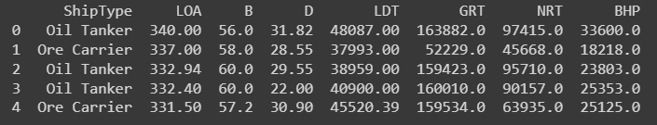
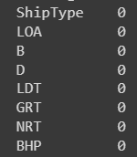
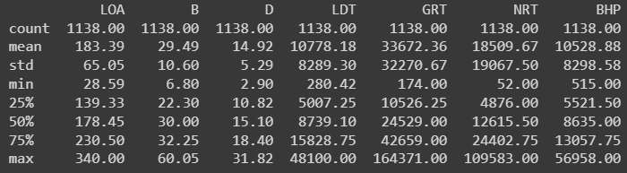
Exploratory Data Analysis
First few rows of the dataset:
Missing values:
Summary statistics:

Slide 7
Exploratory Data Analysis (contd.)

Slide 8
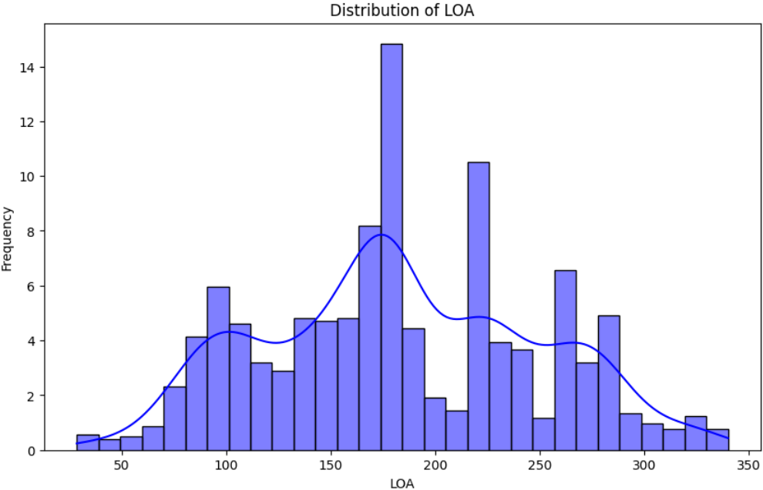
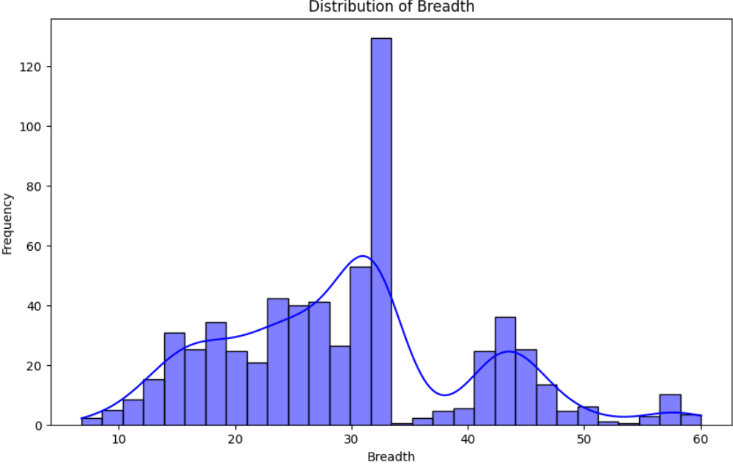
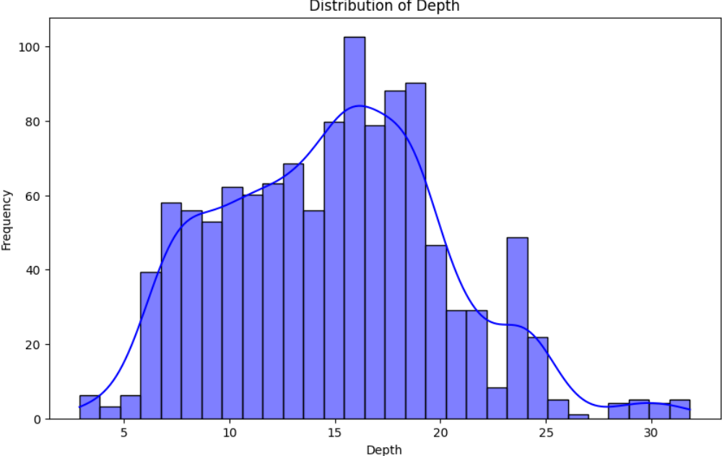
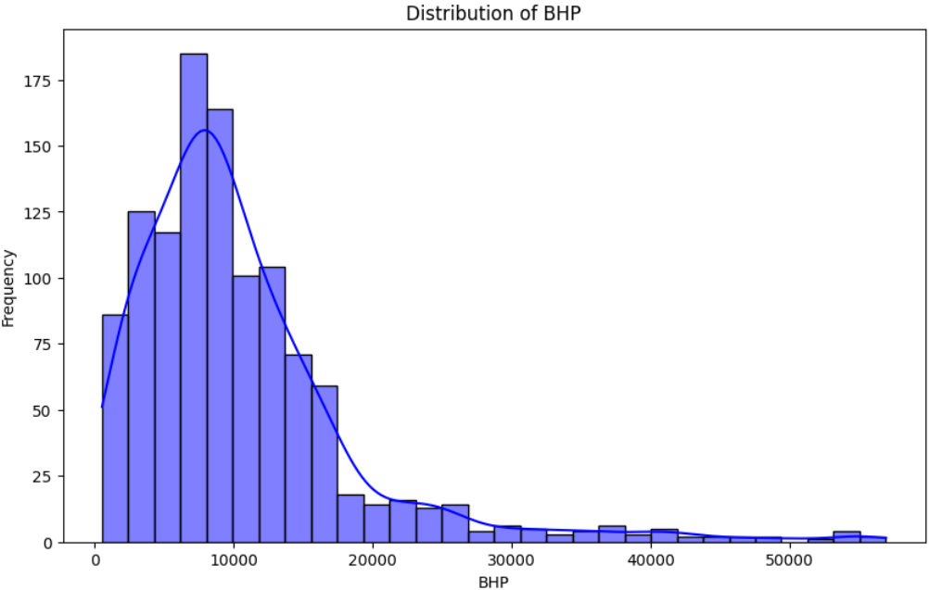
Exploratory Data Analysis (contd.)

Slide 9
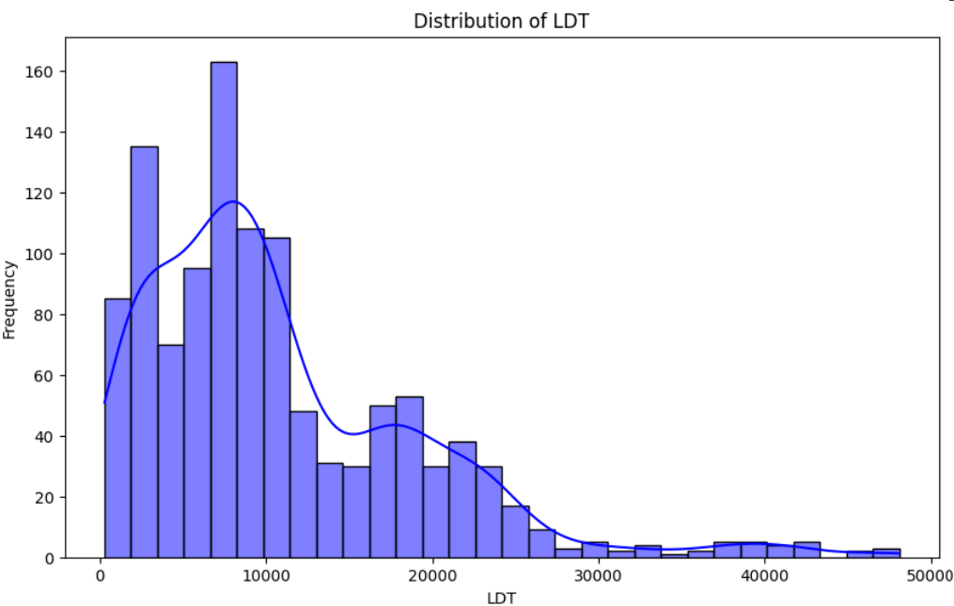
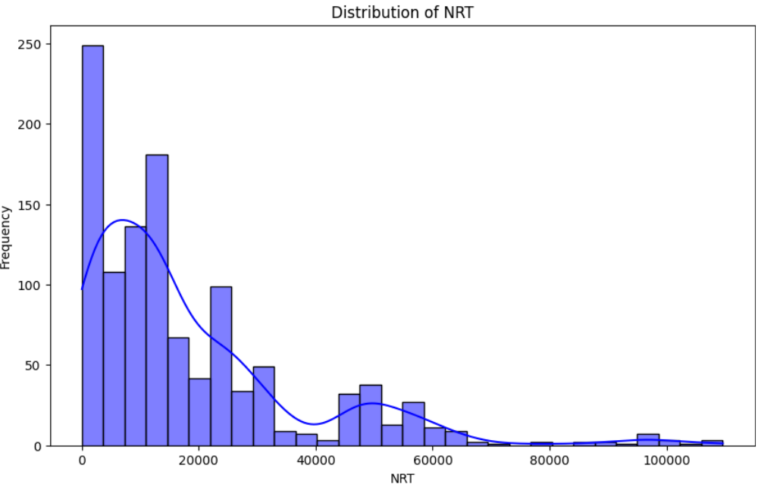
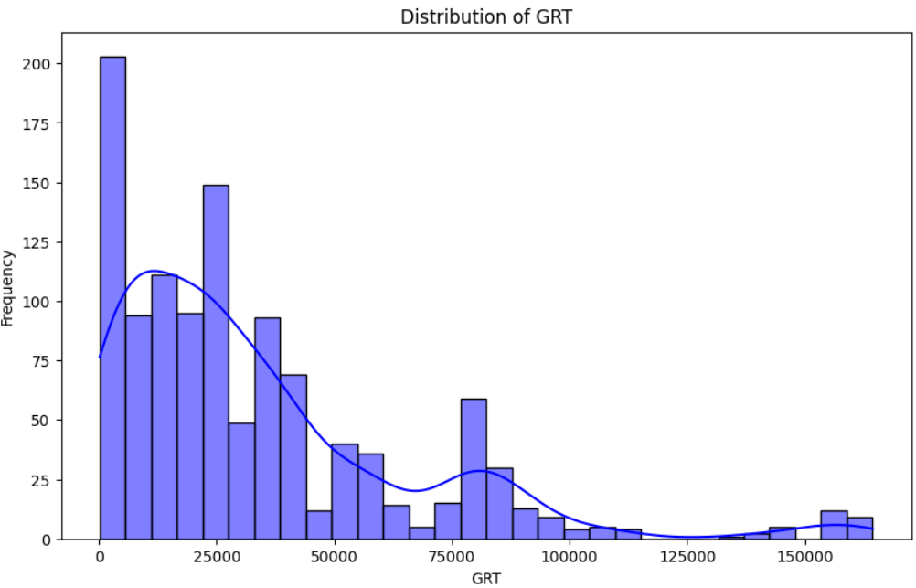
Exploratory Data Analysis (contd.)

Slide 10
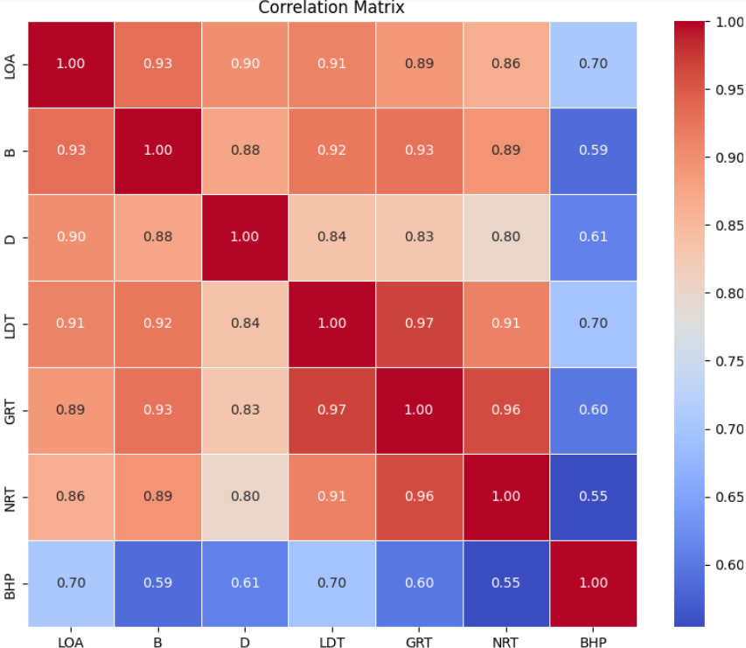
Exploratory Data Analysis (contd.)

Slide 11
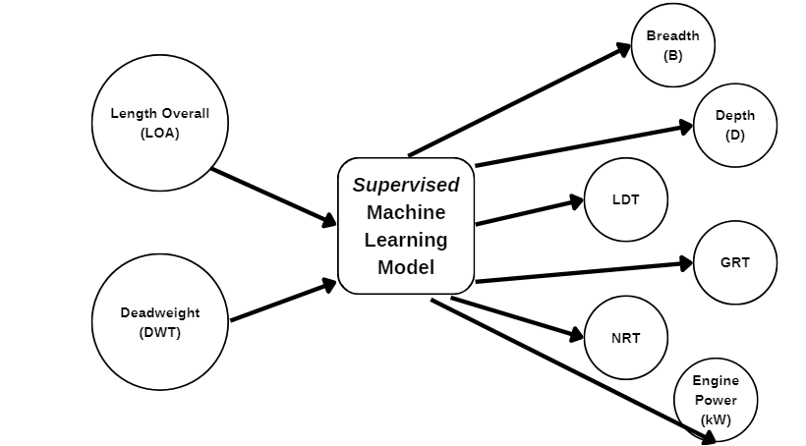
Machine Learning Model Development
Pre-processed Database
Empirical Formulae from Literature

Slide 12
Machine Learning Model Development
Supervised Machine Learning Models Used
Multiple Linear Regression
Lasso Regression
Ridge Regression
Polynomial Regression (4th order)
K-Nearest Neighbors (n=2)
Support Vector Machines (SVM)
Decision Tree
Random Forest
AdaBoost
Gradient Boosting Machines (GBM)
11. xGBoost
12. Artificial Neural Network (ANN)
(Hidden layers = 2
Activation function = ReLu
Optimizer = Adam
Loss function = MSE)

Slide 13
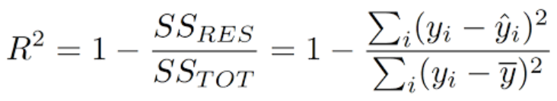
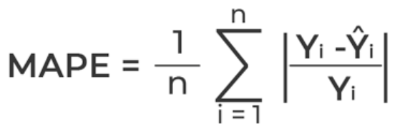

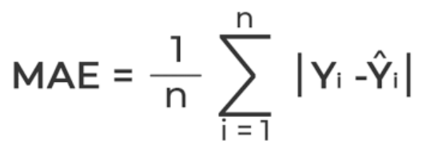
Machine Learning Model Development
Evaluation Metrics Used
R-squared (Coefficient of determination)
2. Mean Absolute Percentage Error (MAPE)
3. Mean Squared Error (MSE)
4. Mean Absolute Error (MAE)

Slide 14
Machine Learning Model Development
Bulk Carriers
Applied Model | R² | MAPE | MSE | MAE
Multiple Linear Regression | 0.865 | 12.9% | 1.018 x 10^7 | 1932.1
Lasso Regression | 0.865 | 12.9% | 1.018 x 10^7 | 1692.1
Ridge Regression | 0.865 | 12.9% | 1.018 x 10^7 | 1692.1
Polynomial Regression (n=4) | 0.879 | 9.25% | 5.893 x 10^6 | 1215.7
K-Nearest Neighbors (n=2) | 0.834 | 8.79% | 6.691 x 10^6 | 1100.3
Support Vector Machines (SVM) | 0.189 | 34.08% | 2.011 x 10^8 | 7204.7

Slide 15
Machine Learning Model Development
Bulk Carriers (contd.)
Applied Model | R² | MAPE | MSE | MAE
Decision Tree | 0.811 | 8.9% | 5.243 x 10^6 | 950
Random Forest | 0.864 | 8% | 4.036 x 10^6 | 901.4
AdaBoost | 0.846 | 15.1% | 1.26 x 10^7 | 2027.6
Gradient Boosting Machines (GBM) | 0.88 | 8.4% | 4.11 x 10^6 | 1012.4
xGBoost | 0.842 | 8.4% | 4.653 x 10^6 | 1005.8
Artificial Neural Network (ANN) | 0.687 | - | 5.899 x 10^7 | 4531.2

Slide 16
Machine Learning Model Development
Oil Tankers
Applied Model | R² | MAPE | MSE | MAE
Multiple Linear Regression | 0.894 | 22.13% | 3.467 x 10^7 | 2763.3
Lasso Regression | 0.894 | 22.13% | 3.467 x 10^7 | 2763.3
Ridge Regression | 0.894 | 22.13% | 3.467 x 10^7 | 2763.3
Polynomial Regression (n=4) | 0.931 | 12.77% | 8.852 x 10^6 | 1439.9
K-Nearest Neighbors (n=2) | 0.87 | 13.11% | 2.894 x 10^7 | 1801.4
Support Vector Machines (SVM) | 0.159 | 128.07% | 5.49 x 10^8 | 11271.5

Slide 17
Machine Learning Model Development
Oil Tankers (contd.)
Applied Model | R² | MAPE | MSE | MAE
Decision Tree | 0.857 | 13.24% | 3.182 x 10^7 | 1787.4
Random Forest | 0.914 | 10.92% | 8.574 x 10^6 | 1202.4
AdaBoost | 0.916 | 24.42% | 1.19 x 10^7 | 1706.1
Gradient Boosting Machines (GBM) | 0.917 | 11.49% | 1.161 x 10^7 | 1290.6
xGBoost | 0.884 | 11.77% | 1.61 x 10^7 | 1489.6
Artificial Neural Network (ANN) | 0.854 | - | 3.55 x 10^7 | 3070.2

Slide 18
Machine Learning Model Development
Container Ships
Applied Model | R² | MAPE | MSE | MAE
Multiple Linear Regression | 0.853 | 18.72% | 1.612 x 10^7 | 1923.6
Lasso Regression | 0.853 | 18.74% | 1.612 x 10^7 | 1923.6
Ridge Regression | 0.853 | 18.72% | 1.612 x 10^7 | 1923.6
Polynomial Regression (n=4) | 0.893 | 12.98% | 1.428 x 10^7 | 1755.6
K-Nearest Neighbors (n=2) | 0.816 | 18.03% | 2.43 x 10^7 | 2380.3
Support Vector Machines (SVM) | 0.248 | 63.59% | 1.168 x 10^8 | 6589.1

Slide 19
Machine Learning Model Development
Container Ships (contd.)
Applied Model | R² | MAPE | MSE | MAE
Decision Tree | 0.849 | 14.57% | 1.86 x 10^7 | 1941.3
Random Forest | 0.897 | 13.46% | 1.276 x 10^7 | 1597.7
AdaBoost | 0.907 | 17.56% | 1.32 x 10^7 | 1687.2
Gradient Boosting Machines (GBM) | 0.905 | 14.47% | 1.323 x 10^7 | 1687.2
xGBoost | 0.888 | 14.38% | 1.585 x 10^7 | 1814.1
Artificial Neural Network (ANN) | 0.611 | - | 4.681 x 10^7 | 4302

Slide 20
Machine Learning Model Development
Cargo Vessels
Applied Model | R² | MAPE | MSE | MAE
Multiple Linear Regression | 0.726 | 18.51% | 1.696 x 10^6 | 692.5
Lasso Regression | 0.73 | 18.5% | 1.696 x 10^6 | 692.5
Ridge Regression | 0.726 | 18.51% | 1.696 x 10^6 | 692.5
Polynomial Regression (n=4) | 0.734 | 17.38% | 1.659 x 10^6 | 639.7
K-Nearest Neighbors (n=2) | 0.642 | 18.28% | 2.07 x 10^6 | 745.4
Support Vector Machines (SVM) | 0.051 | 50.06% | 1.014 x 10^7 | 1895.9

Slide 21
Machine Learning Model Development
Cargo Vessels (contd.)
Applied Model | R² | MAPE | MSE | MAE
Decision Tree | 0.528 | 22.06% | 2.506 x 10^6 | 811.6
Random Forest | 0.638 | 19.53% | 2.037 x 10^6 | 749.3
AdaBoost | 0.684 | 21.92% | 1.963 x 10^6 | 731.9
Gradient Boosting Machines (GBM) | 0.67 | 20% | 1.941 x 10^6 | 737.3
xGBoost | 0.588 | 19.23% | 2.135 x 10^6 | 735.9
Artificial Neural Network (ANN) | 0.551 | - | 3.419 x 10^6 | 1158

Slide 22
Drawbacks
Considered design speed as an input feature, but then discarded due to unsatisfactory correlations.
Not enough data for analysis of minor ship types.
Although complex models might result in better performance, they are essentially a black box from which simple mathematical formulae are difficult to achieve.

Slide 23
Upcoming Work
Further iterations and hyper-parameter tuning will potentially result in better models, and thus better predictions.
Conducting Material Flow Analysis by reviewing relevant literature.

Slide 24
Thank You.

Slide 25
References
Ministry of Industries, Motijheel C/A, Dhaka.
‘Regression Analysis of Ship Characteristics’, G. P. Piko (1980)
‘Regression Analysis for Container Ships in the Early Design Stage’, B. Rinauro, E. Begovic, F. Mauro, G. Rosano; Ocean Engineering (2024)
‘Existing Design Trends for Tankers and Bulk Carriers – Design Changes for Improvement of the EEDI in the Future’, Kristensen, Lutzen (2012)
‘A Step Toward the Preliminary Design of Seagoing Multi-Purpose Cargo Vessels’, Kalajdzic, Momcilovic (2020)
https://towardsmachinelearning.org/

Slide 26
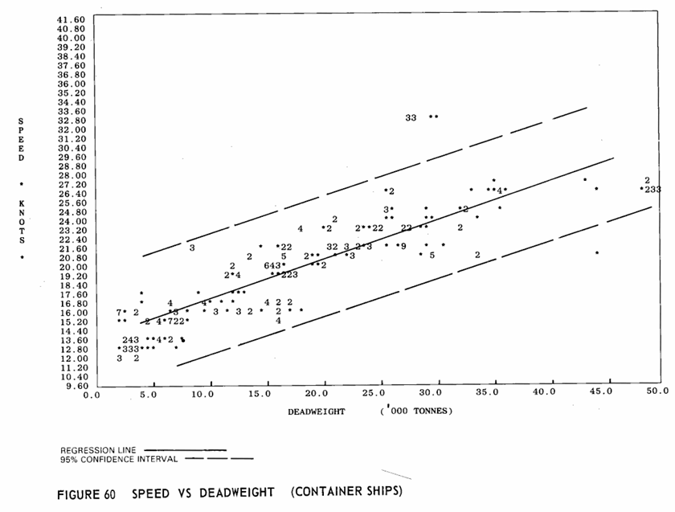
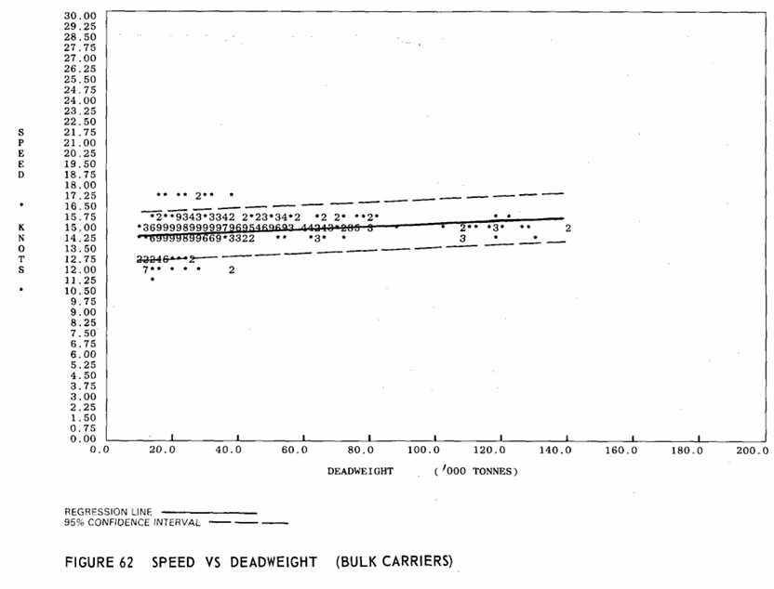
Annex
Regression Analysis of Ship Characteristics, G. P. Piko (1980)
Catalogue: Lloyd’s Register of Shipping, 1977

Slide 27
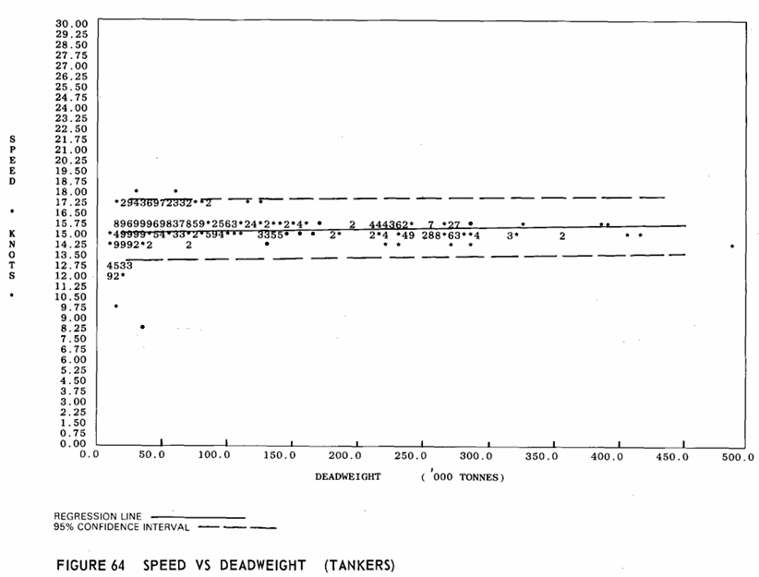
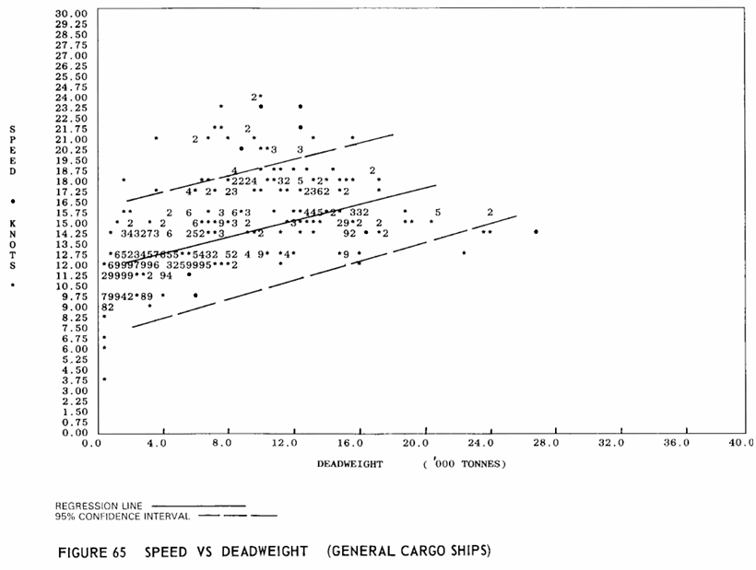
Annex (contd.)
Regression Analysis of Ship Characteristics, G. P. Piko (1980)
Catalogue: Lloyd’s Register of Shipping, 1977

Slide 28
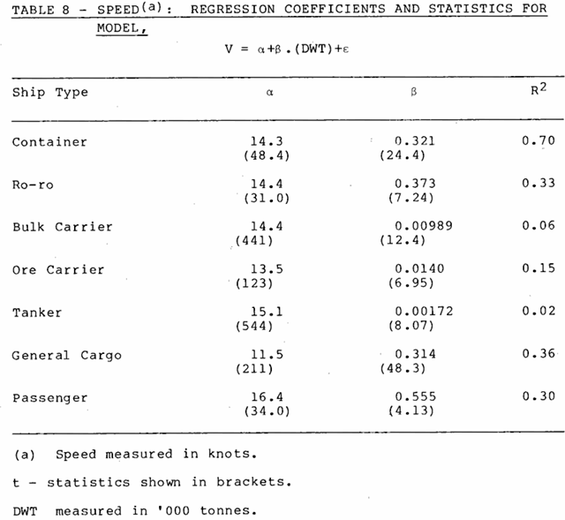
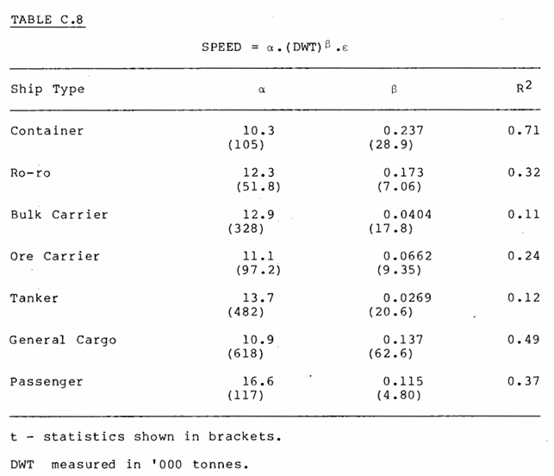
Annex (contd.)
Regression Analysis of Ship Characteristics, G. P. Piko (1980)
Catalogue: Lloyd’s Register of Shipping, 1977

Slide 29
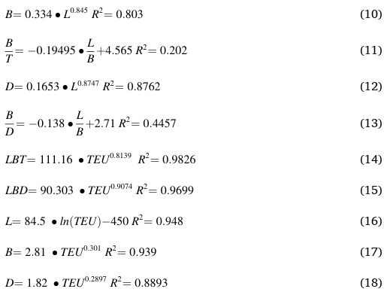
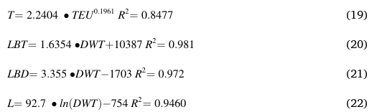
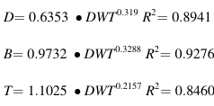
Annex (contd.)
Regression Analysis for Container Ships in the Early Design Stage, B. Rinauro, E. Begovic, F. Mauro, G. Rosano; Ocean Engineering (2024)
Catalogue: Hyundai HI Shipbuilding Group Performance Record, 2022

Slide 30
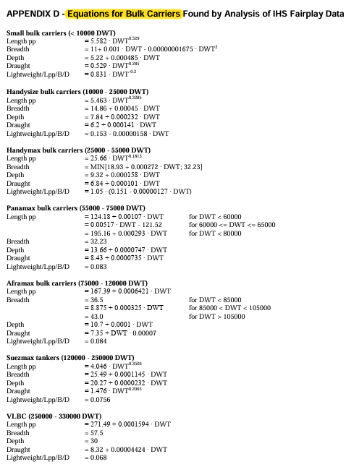
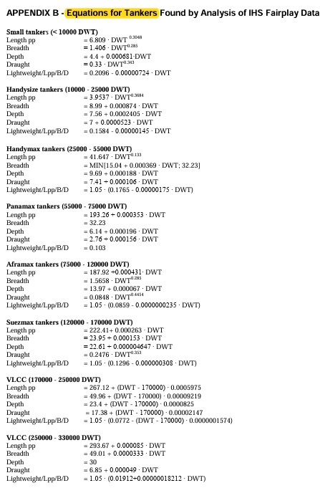
Annex (contd.)
Existing Design Trends for Tankers and Bulk Carriers – Design Changes for Improvement of the EEDI in the Future, Kristensen, Lutzen (2012)
Catalogue: IHS Fairplay Database, 1990-2010

Slide 31
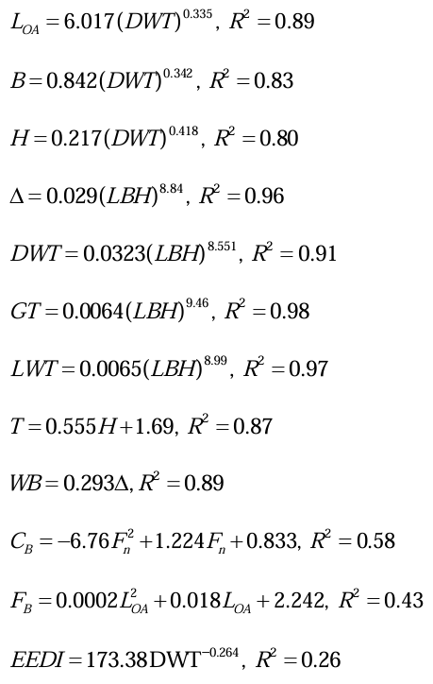
Annex (contd.)
A Step Toward the Preliminary Design of Seagoing Multi-Purpose Cargo Vessels’, Kalajdzic, Momcilovic (2020)
Catalogue: Significant Ships, 1990-2013

Slide 32
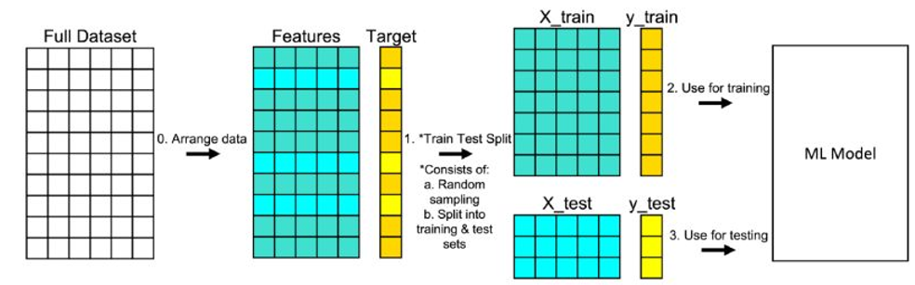
Annex (contd.)
Training and Testing Procedure of Machine Learning Models

Slide 33
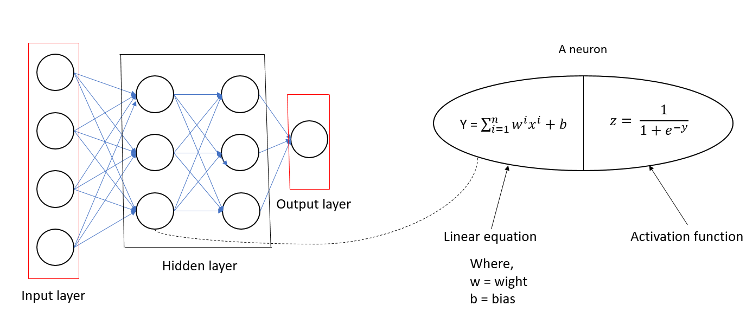
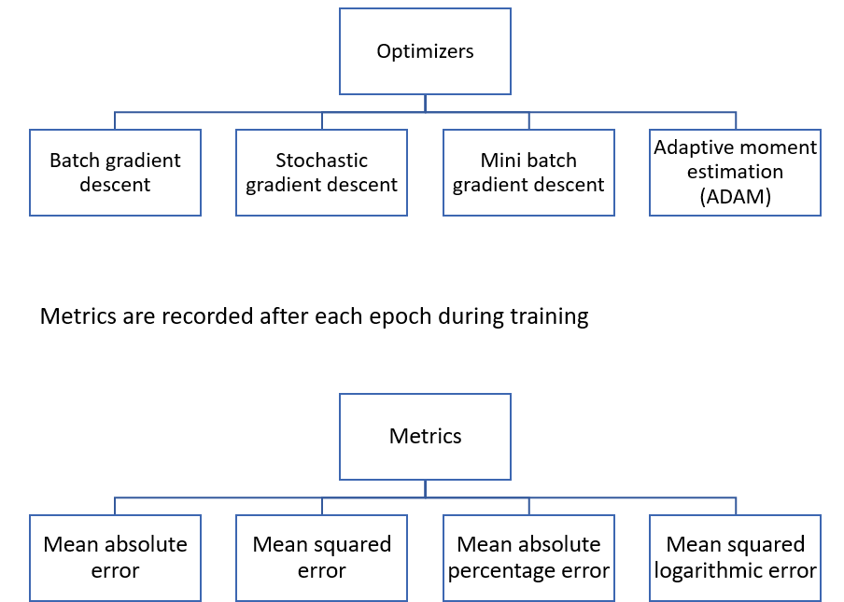
Annex (contd.)
Architecture of a Neural Network

Slide 34
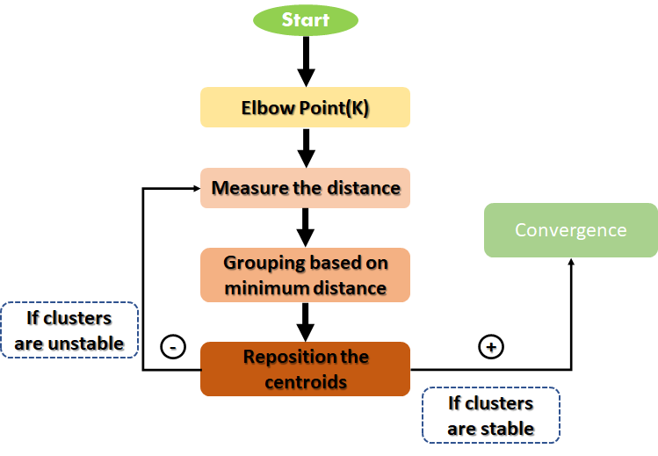
Annex (contd.)
K-Means Clustering Algorithm

Slide 35
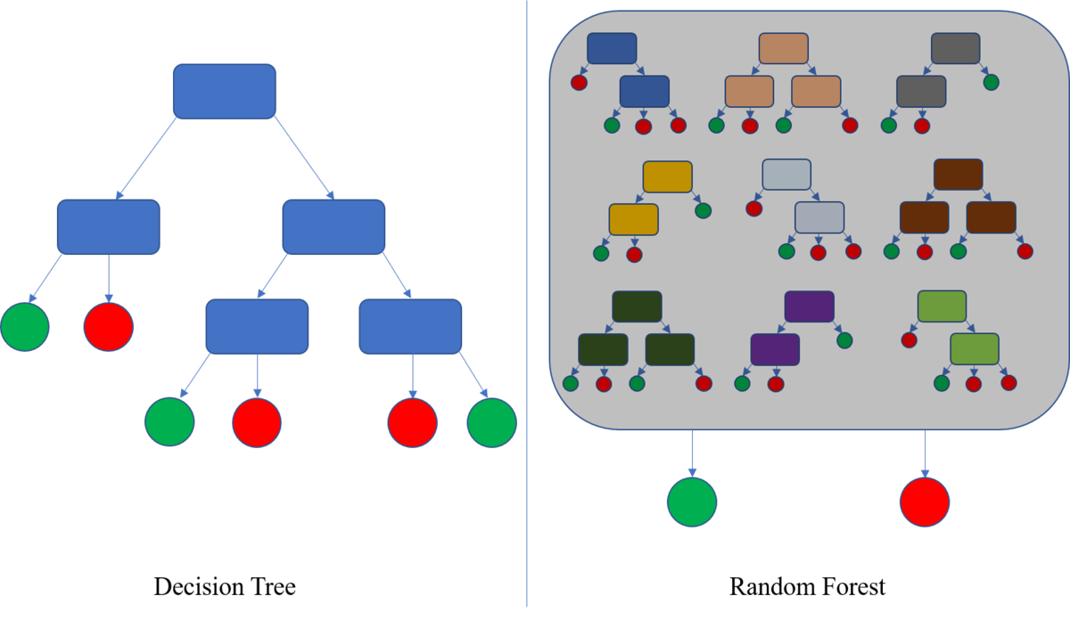
Annex (contd.)
Decision Tree and Random Forest Algorithm

Slide 36
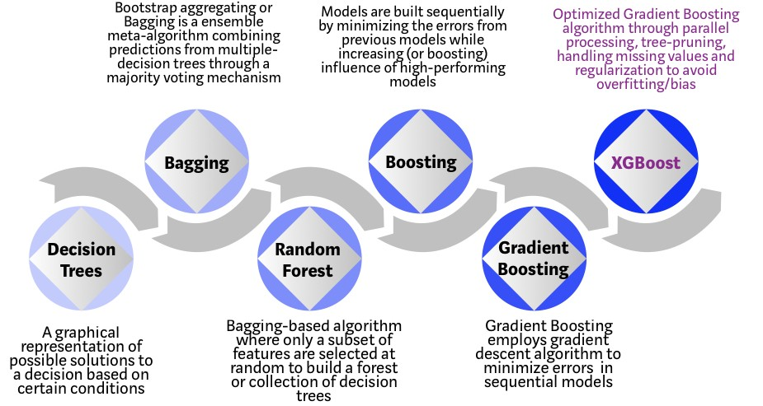
Annex (contd.)
Evolution of the xGBoost Algorithm

Slide 37
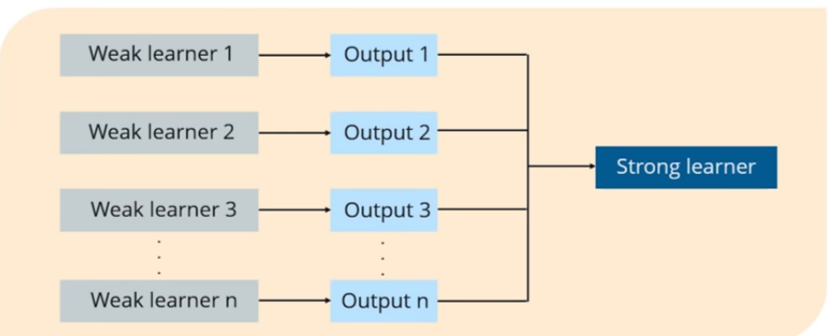
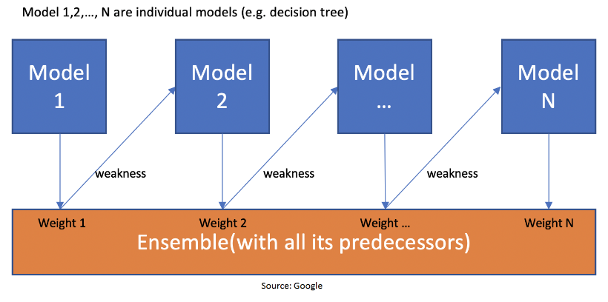
Annex (contd.)
How Boosting Algorithms Work

Slide 38
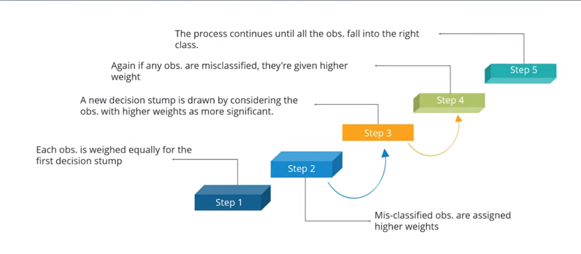
Annex (contd.)
AdaBoost Algorithm

Slide 39
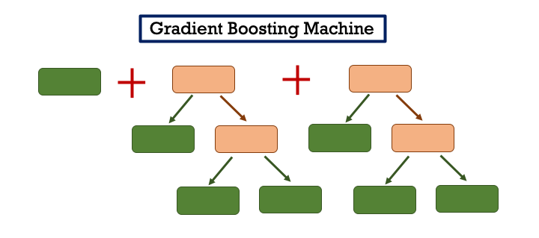
Annex (contd.)
Gradient Boosting Machines (GBM)

Slide 40
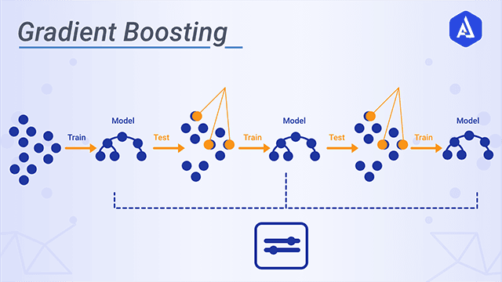
Annex (contd.)
How Gradient Boosting Works

